Slide 1
Careers Nova Scotia
Transforming Employment and Workforce Development Services in Nova Scotia
February, 2015

Slide 2
Presentation Overview
1. The present system and the need for change
2. What we heard through consultation
3. Vision and areas of focus for a new employment and workforce development system
4. Next steps and discussion

Slide 3
What is Labour Market Programming? And Why We Do It…
3. Improving productivity
Through employer-focused training:
Canada Job Grant / Workplace Innovation and Productivity Skills Incentive
Workplace Education
Sector Councils
Economy
Workforce
Population
1. Facilitating greater labour market participation:
Preparing for jobs
Essential Skills Training
Literacy & Numeracy
2. Supporting Workforce Transition and Attachment:
Assessment
Job Search
Re-Skilling
START

Slide 4
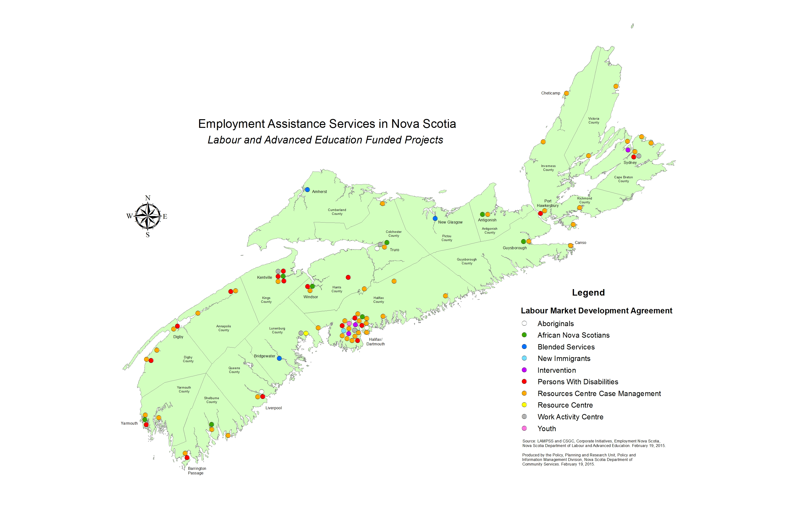
Current Situation
Notes:
Examples of organizations:
PeopleWorx, Community Inc. in the valley
Job Search Centre in Windsor
YMCA in Sydney
In Halifax:
YMCA
Teamwork/Workbridge
Reachability
ISIANS
In Dartmouth:
WADE
*See Appendix C for a list of orgs by riding

Slide 5
Current Situation: Distribution of Federal Funding under the Canada-Nova Scotia Labour Market Development Agreement (LMDA)
Notes:
LMDA: The name of our federal funding agreement

Slide 6
The Impetus for Change: Evolving Priorities and the Changing Landscape
Government Priorities:
One NS Coalition
Fiscal and Demographic
Education Review
Population Plan
DCS Benefit Reform
Plus:
Changes to federal labour market funding agreements
And consensus on the need for change: Group ATN
Notes:
One NS Coalition:
Workforce participation of under-represented groups, immigrants, and income assistance recipients, among others.

Slide 7
What We Heard Group ATN Report: Highlights
Service delivery standards and professional certifications are key
Fewer ‘doors’ to service delivery, with clear options for client supports, important for client access and success
Career planning should be integrated into the P-12 system with emphasis on provision of quality labour market information
Employers should be directly involved
Specialized services requires focused attention in any new model
Group ATN report recommends use of a Request for Proposals (RFP) process to implement a new service delivery model

Slide 8
What We Heard Group ATN Report: Transition Principles
Collaborative approach involving all stakeholders
Consistent and commonly-branded service balanced with flexibility and capacity for local responsiveness
Optimizing technology + encouraging innovative practices (including use of virtual channel)
Focus on outcomes and results will build confidence
Respect of specialized expertise
Strong governance; breaking down of systemic barriers
Positioning Careers Nova Scotia as critical factor in labour force and HR planning of major projects in NS

Slide 9
The Careers Nova Scotia Vision Putting Clients’ Needs First: A successful transformation means…
A small business owner looking for employees is planning for his/her future workforce and is recruiting employees through a local career centre.
Businesses
Demand Side
Funders
External
Careers Nova Scotia
Brand Promise
Service
A job seeker knows where and how to access quality employment services
Government
Providers
Supply Side
All Nova Scotians
A student feels more empowered to chart his/her own career course. A parent knows how to help.

Slide 10
Giving Careers NS Shape One overall goal… three areas of transformation
Advancing Nova Scotians along a workforce continuum and ensuring a current and future labour supply for NS employers through…
Maximum reach and access
Service excellence
Client-focused service delivery

Slide 11
Service Delivery: Three Potential ‘Models’
1. Programs and services integration
How government departments work together to serve clients
Division of work and co-ordination
Key interface and client referral points
2. External service delivery
Does one service provider in each region service all client populations?
Are there 2 or more “tiers “ of service providers within a region?
3. Catchment areas
How many organizations?
How many offices?
Three Main Service Delivery Options
Current State
Hybrid
Blended
SS HRM CB North Valley
SS HRM CB North Valley
SS HRM CB North Valley
Provider - Specified Client Group
2 or more entry points based on Client Group
Common Entry point for all clients

Slide 12
Service excellence: Three areas of focus
Career Practitioner Certification
Standardized Tools and Resources
Quality Assurance
Specified in
Service Provider Agreements
Catchment Areas
Government Department Work Plans
Notes:
Career Practitioner Certification:
Assess success of NSCDA Pilot
Finalize certification requirements, training content and supports
Develop sustainable model for implementation with practical phase-in
Incorporate into service delivery channel model and RFP process
Standardized tools and resources:
Standardized triage and intake at Careers Nova Scotia Centres
Standardized set of assessment tools
Standards for return to work action plans
Standardized job search training supports
Coping With Job Loss
Career Planning
Effective Job Search Strategies
Resume, cover letter writing, interview skills
How to Succeed In the Workplace
Quality Assurance:
Service quality and compliance audits by ENS, imbedded in service provider contracts
Sustainable, risk–managed approach
Affordable, sustainable

Slide 13
Maximum Reach and Access
A framework for connecting with Nova Scotians
Labour Market and Workforce Information
Target Audiences:
Youth; Parents
Consistent Branding
New Canadians
Local Info
Channels:
On-line,
School Boards,
Nova Scotia Community College,
Service Providers,
Community Learning Organizations,
Influencers
Information products:
client-centric
content,
packaging and messaging; standardized EI Claimant Outreach
Under-represented groups
Job Bank
Labour Market Information
EI Job Seekers
Income Assistance Recipients
Service Info
Occupational Info
Adult Learners
Under-employed
EI Claimant Information
Employers
Sample
Deliverables
Info Strategy
Brand Strategy
Channel Strategy
Evaluation
Info Sharing Agreements
Specific Info Products
Service Agreements
Notes:
Co-ordinate and structure efforts in context of Careers Nova Scotia:
Access to What
Reach Whom
By What Means
We are focusing on:
Creating a consistent brand… people will know when they see our brand what they can get and they will trust in the quality of the services they receive
Creating user-friendly LMI and other quality products that help students, parents and job seekers connect to information, and that help employers in the area of HR and workforce planning
Creating virtual tools and options, such as online assessments, phone triage options, along with the continued in-person options. Over time, we anticipate that more and more people will find what they need through online venues, lessening the need for infrastructure and freeing up resources for better quality client interventions

Slide 14
Next Steps
Continue discussions with DCS, EECD, School Boards
Engage business, community learning organizations, NSCC
Continue work on virtual channel, LMI, certification, standardized resources and service standards
Complete work on service delivery model
Develop options for government
Continue to engage with you on common tools, branding etc., and on the transition process
Notes:
We want to accept Group ATN’s recommendations
People will ask about our commitment to specialized groups: we can commit to retaining a focus on these groups as key client groups who we want to support to attach to the labour market
People will see the term RFP highlighted as a recommendation; we want to start to socialize this now, be open and transparent, allow them to start to prepare with partnerships, etc.
Based on the positive response to date to the NSCDA pilot, we expect that people will be excited about the focus on service excellence, and anxious to have access to better tools and resources.
People may question how they will handle increased client work with an expansion to a wider clientele. We can acknowledge that this will be taken into consideration when developing the new service delivery framework.
People may question what ‘integration’ means when presented with the term from the report; I think we need to be honest in pointing out best practices that show service integration with clear client pathways as a preferred option, while maintaining commitment to specialized services to those who require it.

Slide 15
Thank You!
Questions?

Slide 16
Adult Learning Centers
How (if at all) are you working with Careers Nova Scotia Centers now?
What opportunities do you see to strengthen that connection in the future? What would the benefits be?
De quelle façon travaillez-vous avec les centres Carrières Nouvelle-Écosse à l’heure actuelle?
Quelles sont les possibilités de renforcer ce lien dans le futur? Quels seraient les avantages?

